Slide 1
Frontline Forecast
University of North Texas
Predict Length of Stay and Optimize Bed Allocation
Kate Dau · Aarya Acharya · Sakeet Kopparapu · Sulav Regmi
Michel Fathi
Notes:
Hello everyone, we’re Frontline Forecast from the University of North Texas. My name is ……., and these are my teammate…… and we’d also like to thank Professor Fathi for guiding this project.

Slide 2



Introduction & Problem Statement
Why this problem matters ?
Overcrowded
Waste of Resources
Delays in Care
85–95%
Bed occupancy
4–6 hrs
ER wait time
10–15%
Unused beds
$2K–$4K
Cost per extra day
20–40%
Longer wait times
+0.5–1 day
Per patient delay
THREE QUESTIONS THAT SHAPED OUR INVESTIGATION
Q1
Which patient subgroups are hardest to predict — and what makes them so?
Q2
What signals at admission most reliably indicate a prolonged stay?
Q3
Can encounter-level data alone flag patients ready for early discharge?
Notes:
Quick question — just think to yourself…
how many of you have ever gone to the ER… and then later looked at the bill and thought: ‘Wow, I should’ve just stayed sick.’
Or maybe this — you’re sitting in the waiting room… it’s been an hour… maybe two… ..and you start wondering — ‘Did they forget me… or did I accidentally check into a hotel?’
And here’s the funny part — a lot of times, it’s not because hospitals don’t care… and it’s not even because they don’t have enough staff or beds → It’s because they don’t know… how long patients are going to stay
And when that estimate is off — even by just one day —everything starts to break down: overcrowding, delays, and wasted resources.
So even small estimation errors can quickly turn into system-wide problems.
Instead of asking, ‘How do we add more resources?’ we asked a different question: What if we could just make better decisions… with the data we already have?
→ That’s exactly what our project is about

Slide 3
Data & Analytical Approach
Dataset, Features & Modeling Approach
DATA SOURCE
MODELING APPROACH
1
Regression: Predict exact LOS
UCI Diabetes 130-US Hospitals
101K patients from 130 hospitals
How many days will the patient stay?
FEATURES
2
Classification: Long vs Short Stay
Demographic | Clinical | Usage
Short vs long stay
3
Uncertainty Estimation
TOOLS
SAS Viya Workbench
Give a range, not just a number
4
Decision (Simulation)
Test real-world scenarios
Notes:
To answer that, we worked with a dataset of over 100K patients across 130 hospitals, combining three types of information:
who the patient is,
their clinical condition,
and how they use hospital services.
We used a set of approaches to improve both prediction accuracy and make the results more useful for decision-making
First, we predict how long a patient will stay — so hospitals have a baseline estimate.
Then, we classify patients into short or long stays, which helps prioritize attention
But in real life, one number is not enough, So instead of saying ‘this patient will stay 3 days, we provide a range, like 2 to 6 days — similar to a weather forecast.
And finally, we simulate real-world scenarios to see how these predictions affect hospital operations
→So the goal is not just to predict…but to provide information that hospitals can actually act on

Slide 4
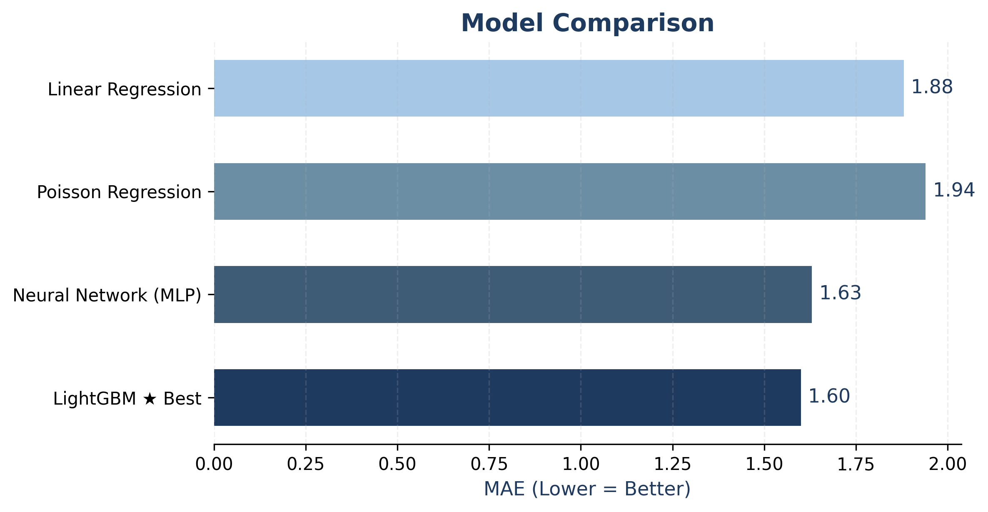
Key Results
LOS Regression & Long-Stay Classification
LOS REGRESSION COMPARISON -MAE
LONG-STAY CLASSIFICATION
(≥ 3 days)
1
Logistic Regression — Baseline
Acc: 77.8% · ROC-AUC: ~0.83
2
Gradient Boosting — Intermediate
Acc: ~77% · ROC-AUC: ~0.83
3
Neural Network (MLP) — ★ Best
Acc: 78.3% · ROC-AUC: 0.837
Notes:
"Alright, so let's talk about what our models actually produced."
We tested two things. First, can we predict exactly how many days a patient will stay? And second, can we simply flag patients who will stay 3 days or longer?
For the prediction side, you can see the bar chart on the left. Lower is better here. Linear Regression gave us an error of 1.88 days, Poisson was slightly worse at 1.94. Our Neural Network improved that to 1.63 days, and our best model — LightGBM — got it down to just 1.60 days on average. So in practice, our best model is only off by about a day and a half, which is quite good given how unpredictable hospital stays can be.
On the right side is our classification task — just answering yes or no: will this patient stay 3 or more days? Our simple Logistic Regression baseline already hit 77.8% accuracy. Gradient Boosting matched that at around 77%. And our Neural Network came out on top at 78.3% accuracy with an AUC of 0.837. All three models performed competitively, with the Neural Network taking the win.

Slide 5
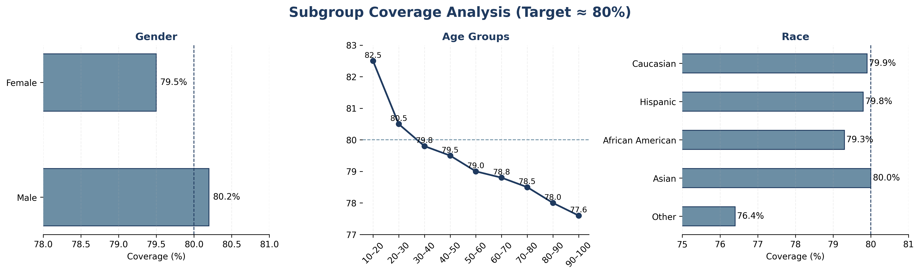
Key Results
Uncertainty Estimation & Feature Importance
SAS® Curiosity Cup 2026 · Frontline Forecast · University of North Texas
Notes:
"Now, a good model isn't just accurate overall — it should work fairly across different groups of patients. That's what this slide checks."
We asked: do our prediction intervals — our uncertainty ranges — hit the 80% target equally well for men and women, for different age groups, and for different racial groups?
Starting with gender — both groups are right on target. Males at 80.2%, females at 79.5%. No issue there.
For age, there's an interesting pattern. Younger patients actually over-cover — the 10 to 20 age group hits 82.5%. But as patients get older, coverage drops slightly. The 90 to 100 age group falls to 77.6%. That makes sense — elderly diabetic patients are simply harder to predict because their health situations are more complex.
For race, most groups land very close to 80%. The one exception is the "Other" category at 76.4%, which is likely just because that group has fewer patients in the dataset, making calibration trickier.
Overall though, the model is fair and consistent across groups — which is really important before deploying anything in a healthcare setting.

Slide 6
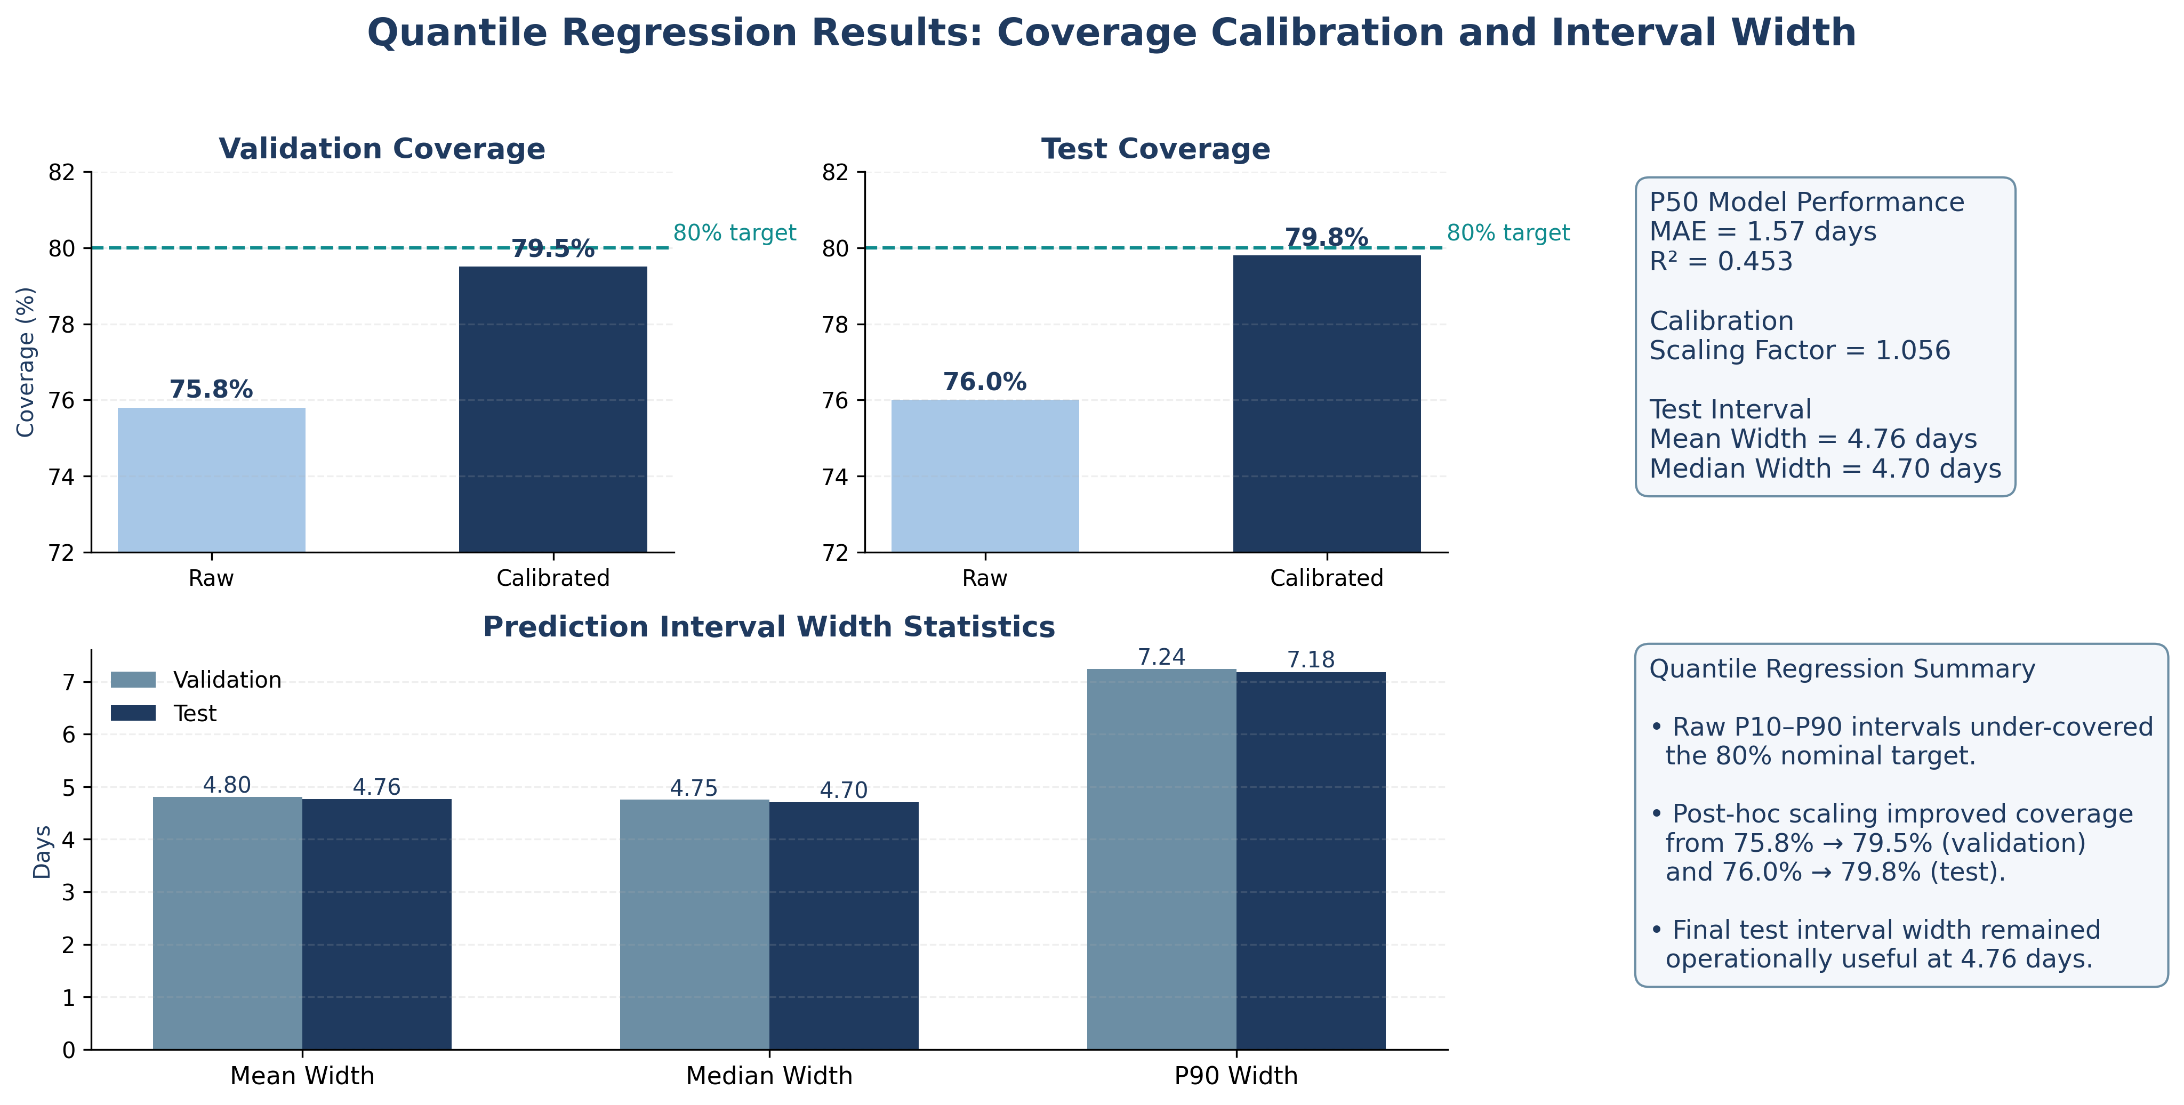
Key Results
Uncertainty Estimation & Feature Importance
SAS® Curiosity Cup 2026 · Frontline Forecast · University of North Texas
Notes:
"This slide is about how we made our prediction ranges more reliable."
So our model doesn't just say "5 days" — it says "somewhere between 3 and 8 days." That range needs to be accurate. If we say 80% of patients will fall within the range, it should actually be 80% — not 70%, not 90%.
When we first built the model, the raw intervals were only capturing about 76% of patients — falling short of our target. So we applied a small correction, essentially widening the intervals just a little, using a scaling factor of 1.056.
After that fix, coverage jumped to 79.8% on test data — right at our 80% goal. You can see that improvement clearly in the top two bar charts — the dark bars are the calibrated version, both sitting right at the dashed target line.
The bottom chart shows the interval widths. On average, our range spans about 4.76 days. So we're telling hospitals "expect this patient to stay within roughly a 5-day window." That's tight enough to actually be useful for planning beds and staffing.
The P50 median model also has an MAE of 1.57 days and an R² of 0.453 — meaning the center of our range is already a solid estimate on its own.
"So in short — we fixed our intervals to be accurate, and they're still practical enough to help hospitals plan ahead."

Slide 7
Key Results
Uncertainty Estimation & Feature Importance
TOP FEATURES
Number of Medications
0.1037
Primary Diagnosis
0.0664
Number of Lab Procedures
0.0346
Largest impact: 0.1037 AUC drop
Stronger than diagnosis and demographics
Reflects treatment intensity at admission
👉 Clinical factors drive LOS more than demographic characteristics
Number of Procedures
0.0114
Secondary Diagnosis
0.0080
Tertiary Diagnosis
0.0071
Max Glucose Serum
0.0045
Age
0.0039
SAS® Curiosity Cup 2026 · Frontline Forecast · University of North Texas
Notes:
"Finally, let's look at what the model actually learned — which factors matter most for predicting a long hospital stay."
This chart ranks features by how much the model's performance drops when that feature is removed. The bigger the drop, the more important the feature.
The clear number one is Number of Medications, with a score of 0.1037. That's more than twice the importance of the next feature. Think about it — if a patient comes in already on many medications, that tells you they're managing multiple conditions. They're complex cases, and they tend to stay longer.
Second is Primary Diagnosis at 0.0664, followed by Number of Lab Procedures and Number of Procedures. All of these are clinical — they reflect what's medically happening with the patient on day one.
Now look at the bottom of the chart — Age scores just 0.0039. Demographic factors like age, race, and gender barely move the needle compared to clinical ones.
The big takeaway here is this: it's not who the patient is that predicts a long stay — it's how medically complex they are when they arrive. That's actually a really useful insight for hospitals. It tells them to focus discharge planning resources on patients with high medication counts and intensive lab work, not just older patients.

Slide 8
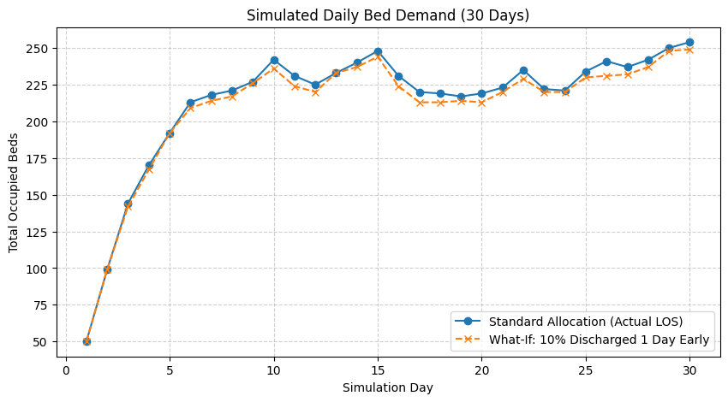
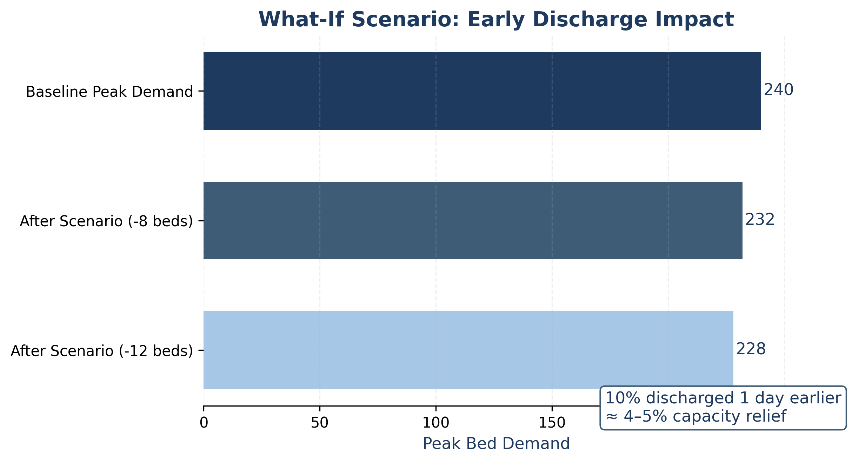
Key Results
WHAT-IF SCENARIO
Notes:
"Now let's move from prediction to decision. What if hospitals didn't need more beds , just slightly better decisions?"
"This chart simulates 30 days of bed usage. The blue line is today's reality. The orange line shows one small change , discharging just 10% of patients one day earlier. That's it. And you can see the orange line is consistently lower, every single day."
"At peak demand, the hospital needs around 240 beds. With that one change, it drops to 232 ,and in the best case, 228. That's 8 to 12 fewer beds needed per day. About a 4 to 5 percent reduction."
"To put that in perspective , 10 freed-up beds means fewer patients waiting in the ER, faster admissions, and less pressure on staff. Every single day."
"So, the takeaway is simple ,we don't always need more resources. Sometimes we just need better decisions. And that's exactly what our model helps enable."

Slide 9
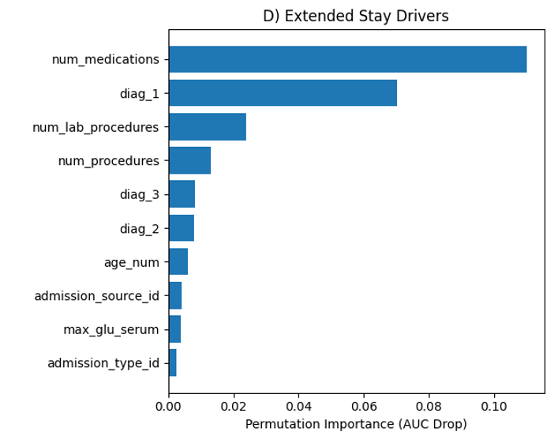
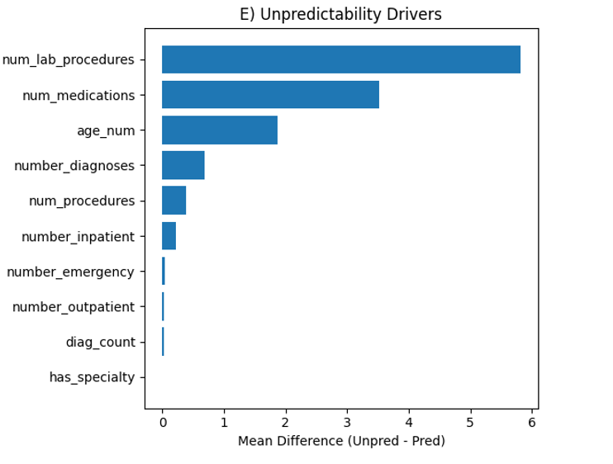
Insights & Conclusions
01 — Medication Burden is the Strongest LOS Signal
02 — Clinical Complexity Drives Unpredictability
Notes:
[Panel D → Key Result 02: Medications] "The first thing we found is that the number of medications a patient is on is the single strongest signal for predicting a long stay. More medications generally means more complexity and that shows up clearly in the data."
[Panel E → Key Result 01: Unpredictability] "We also asked : why are some patients so hard to predict? The answer wasn't age or demographics. It was clinical activity , patients with more lab tests and more medications were the hardest to forecast. Unpredictability is a medical complexity problem, not a people problem.

Slide 10
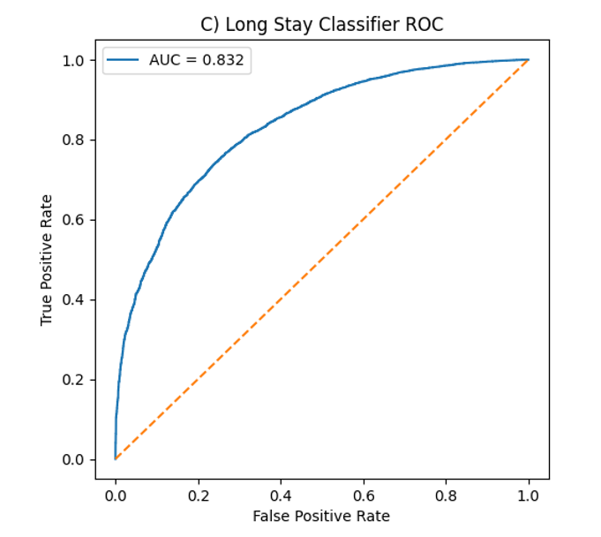
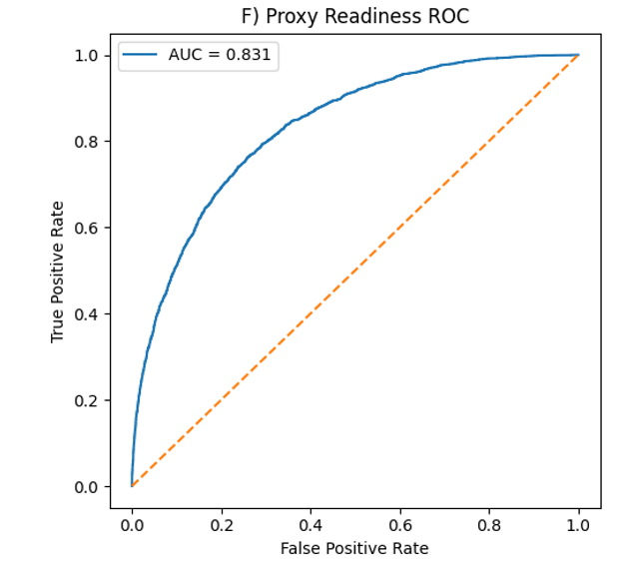
Insights & Conclusions
03 — Early Discharge is Moderately Predictable
Notes:
"We then tested whether we could identify patients likely to leave early. The model did well , it correctly identified those patterns about 83% of the time. But we also know it has limits ,it works best for general planning, not day-by-day decisions."

Slide 11
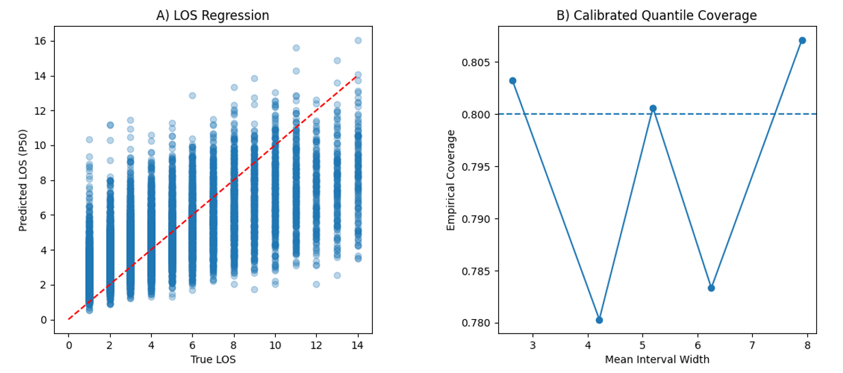
Insights & Conclusions
04 — Small Operational Shifts Have Measurable Impact
Notes:
Key Result 04: Operational Impact] "And finally even small improvements matter. If we discharge just 10% of patients one day earlier, that frees up 8 to 12 beds per day. That's a real, measurable difference in hospital capacity.“
"So the takeaway is , the model is reliable, actionable, and even modest changes can have meaningful impact."

Slide 12
Recommendations & Next Steps
7
RECOMMENDATIONS
LIMITATIONS
★
Deploy LightGBM + Quantile Uncertainty
! Poisson model not fully converged — metrics are a lower bound
Predictive strength, calibrated uncertainty intervals, and scalable training make it ideal for operational deployment. Replace point-estimate LOS with P10–P90 bounds.
! Discharge-readiness proxy needs time-series EHR data for real deployment
! Single-dataset study — external validity across hospitals unconfirmed
▲
! Simulation assumes constant 50 daily arrivals; real demand varies
Target High-Complexity Patients for Early Discharge
Focus proactive coordination on patients with high medication burden and lab intensity. Simulation confirms even 10% early discharge yields 4–5% peak demand relief.
FUTURE WORK
01
Live EHR Integration
02
Multi-Hospital Validation
◆
Integrate Bed Simulation into Daily Planning
Real-time hospital data streams
Diverse patient populations
Use the 30-day rolling simulation for advance staffing decisions — high-demand periods can be identified days ahead, enabling proactive capacity preparation.
03
Real-Time SAS Viya Dashboard
04
Sequential Discharge Modeling
Operational tool for bed managers
Time-series EHR for next-day forecasts
SAS® Curiosity Cup 2026 · Frontline Forecast · University of North Texas
Notes:
"So what do we actually recommend hospitals do with all of this?"
Based on everything we found, we have three core recommendations:
First — replace single-point LOS estimates with our LightGBM model paired with quantile uncertainty bounds. Instead of saying "this patient will stay 5 days," you give the care team a range — P10 to P90 — so they can plan for the best and worst case. It's more honest, and operationally more useful.
Second — use that model to proactively target high-complexity patients for early discharge. The patients with the highest medication burden and lab intensity are your biggest levers. Our simulation showed that discharging just 10% of patients one day early can reduce peak bed demand by 8 to 12 beds per day — that's a 4 to 5% relief. A small operational shift, a real impact.
Third — integrate the 30-day rolling bed simulation into daily planning. This isn't just a research model — it's a decision tool. Bed managers can see high-demand periods days in advance and prepare staffing proactively, not reactively.
Now, we're honest about our limitations. Our discharge-readiness model works well at 78% accuracy, but true next-day forecasting really needs real-time EHR time-series data — something our static dataset couldn't provide. And our simulation assumes constant daily arrivals, which real hospitals don't have.
That brings us to future work. The four things we want to build next are: live EHR integration, multi-hospital validation, a real-time SAS Viya dashboard for bed managers, and sequential discharge modeling using time-series EHR data.
The foundation is here. The models work. The next step is getting this into the hands of the people who actually run hospitals.

Slide 13
Thank you
Hoang Thanh Ngan Dau (Kate) · NganDau2@my.unt.edu
Aarya Acharya · AaryaAcharya@my.unt.edu
Sakeet Kopparapu · SakeetKopparapu@my.unt.edu
Sulav Regmi · SulavRegmi@my.unt.edu
Notes:
And with that — thank you so much. We're the Frontline Forecast team from the University of North Texas — Kate, Aarya, Sakeet, and Sulav. Our contact info is on the screen, and we'd love your questions.

